Slide 1



ACC1020H
TAXATION

Slide 2
LEARNING OBJECTIVES
Define and understand the concept of taxation
Identify and determine the components of taxable income. This includes:
Gross income
Exemptions
Deductions
Taxable Capital Gains
Calculate normal tax payable
Identify when and how the relevant VAT principles should be applied
Calculate VAT payable to/refundable from SARS

Slide 3

WHAT IS TAXATION?
Method of the state collecting funds in order to fund the major departments of a country, make services available and redistribute wealth

Slide 4
MAXIMS OF TAXATION
Everyone ought to contribute towards the support of the government in proportion to their income. (EQUITY)
The tax to be paid by each individual ought to be certain, not arbitrary. (CERTAINTY)
Taxes ought to be levied in such a manner and at the time most convenient to the contributor. (CONVENIENCE)
The collection cost of taxes ought to be as low as possible. (ECONOMY)

Slide 5


SOUTH AFRICAN TAX SYSTEM

Slide 6
ANNUAL BUDGET
Each year the Minister of finance presents the annual budget to the Parliament.
The total expenditures of the government for the fiscal year is announced and the manners in which the expenditures is to be funded.
Expenditure is mainly funded by means of taxation and the balance is funded by loans and sundry government funding.
The government fiscal year is for the period 1 April to the 31 March of the following year.

Slide 7
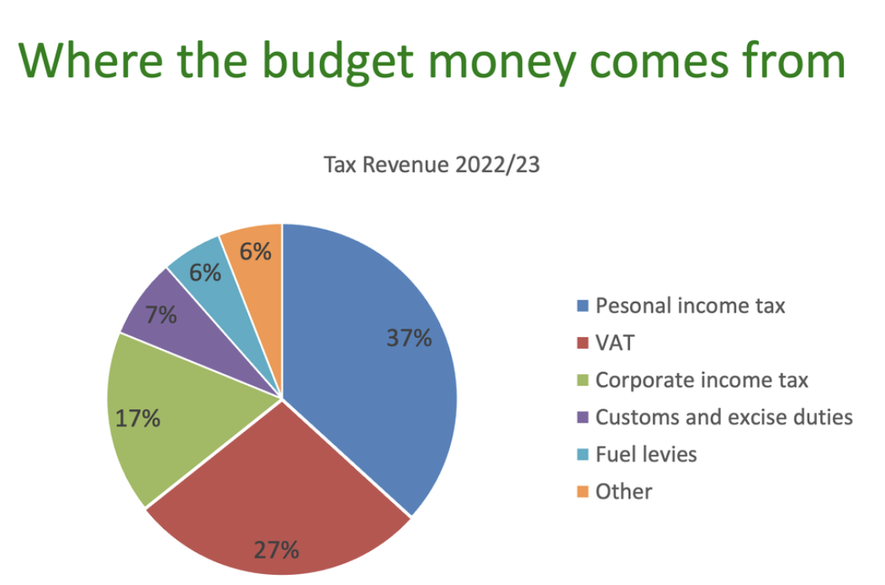
ANNUAL BUDGET

Slide 8
TYPES OF TAXES
DIRECT TAXES (taxes on a person)
Normal Tax
Income Tax
Capital Gains Tax
Donations Tax
Dividends Tax
Withholdings Tax
Turnover Tax
Estate Duty
INDIRECT TAXES (taxes on a transaction)
Value-Added Tax
Transfer Duty
Securities Transfer Tax
Customs and Exercise Duty
Notes:
The one’s in bold are the only one’s they need to know for this course

Slide 9
TAX AVOIDANCE VS TAX EVASION
Tax avoidance is legal – It is the legal use of tax laws and rules in such a way that it reduces your tax burden and results in you paying the lowest possible tax.
Even though it is not illegal, tax avoidance is not always ethical and SARS targets aggressive tax avoidance
Tax evasion is illegal – It is taking illegal steps to avoid paying tax. For example, understating the amount of tax you owe.
If you are caught for evading taxes the result is usually criminal charges and high penalities
Notes:
The one’s in bold are the only one’s they need to know for this course

Slide 10
NORMAL TAX

Slide 11
NORMAL TAX
Normal tax is determined according to the taxable income of a person earned during the year of assessment.
Taxable income is therefore the base on which normal tax is calculated.
Taxable Income of a person is calculated for a particular year of assessment.
Person:
Incudes: natural persons, companies, trusts, estates, organisations and clubs
Year of assessment:
Individuals: 1 March – 28 February
Company: Financial year

Slide 12
NORMAL TAX
Individuals are taxed according to the tax tables
Companies are taxed at a flat rate of 27% (for years of assessment ending on or after 31 March 2023). Previously it was 28%
The Income Tax Act dictates how Normal Tax is calculated.

Slide 13
NORMAL TAX
Taxable Income Framework
Gross Income | XXX
Exemptions | (XXX)
Income | XXX
Deductions | (XXX)
Taxable Capital Gains | XXX
Taxable Income | XXX
Taxable Income x Tax Rate (27%) = Normal Tax for a company

Slide 14
GROSS INCOME
Gross income is the starting point of the taxable income calculation.
Gross income is defined as (general definition):
The total amount
In cash or otherwise
Received by, accrued to or in favour of a person
During the year or period of assessment
Excluding receipts and accruals of a capital nature
Special inclusions – annuity, services rendered, restraint of trade etc
Notes:
Give examples to the students of gross income – revenue or salary, interest, or any bonuses.

Slide 15
EXEMPT INCOME
Exempt income is an amount included in gross income
But then exempted from normal tax in terms of section 10 of the Income Tax Act
An amount must be included in gross income before it can be exempt
Examples of exemptions:
Local dividends received (full dividend is exempt)
Natural persons qualify for the following interest exemptions:
Natural persons under 65: R23 800
Natural persons 65 and older: R34 500

Slide 16
DEDUCTIONS
Reduces income by expenditure incurred in the business
General deduction formula:
Expenditure and losses
Actually incurred
During the year of assessment
In the production of income
Not of a capital nature
To the extent that it is laid out or expended for the purposes of trade
Specific deductions – legal expenses, repairs, bad debts etc
Notes:
Emphasize the difference between an exemption and a deduction

Slide 17
LECTURE EXAMPLE 1
Example 1
Prepcor (Pty) Ltd is a manufacturer and retailer of clothing. Prepcor (Pty) Ltd is a South African resident company with a financial year ending 31 December. During the 2023 year of assessment the company received and incurred the following amounts:
Cash sales of R1 500 000 and credit sales of R1 000 000
Dividends received from local companies of R500 000
Interest received on a local fixed deposit of R20 000
Paid salaries to employees of R350 000
Other operating expenses of R200 000
Required
Using the above information, calculate Prepcor (Pty) Ltd’s normal tax for the 2023 year of assessment.

Slide 18
LECTURE EXAMPLE 1
Example 1 - solution
Normal tax: 1 970 000 x 27% = R531 900
Description | Workings/Calculations | Taxable Income
Sales (Gross income) – earlier of receipt or accrual | 1 500 000 + 1 000 000 | 2 500 000
Dividends received (Gross income) – special inclusion |  | 500 000
Dividends exemption – full exemption |  | (500 000)
Interest received (Gross income) | No exemption for companies | 20 000
Salaries – in the production of income |  | (350 000)
Other operating expenses - in the production of income |  | (200 000)
Taxable Income |  | 1 970 000

Slide 19
CAPITAL GAINS TAX
This is not a separate tax but rather included the taxpayers taxable income
Where a taxpayer disposes of an item that is capital in nature, capital gains tax must be considered
There are 4 requirements for Capital Gains Tax:
Asset
Disposal
Proceeds
Base Cost

Slide 20
CAPITAL GAINS TAX
Capital gains tax – basic calculation
Proceeds | XXX
Less: Base Cost | (XXX)
Capital gain/capital loss | XXX
Proceeds is the amount received or selling price of the asset
Base cost is the original cost of the asset
*Both proceeds and base cost is reduced by certain amounts – this is however outside of the scope of this course

Slide 21
CAPITAL GAINS TAX
Calculate the capital gain or capital loss per asset sold
Aggregate all the capital gains and losses from the year of assessment
If this results in an aggregate capital loss – carry forward to the next year of assessment to set off against capital gains (a capital loss can never be included in taxable income)
If this results in an aggregate capital gain – multiply by the inclusion rate of 80% for companies
An individual gets an annual exclusion of R40 000 and has an inclusion rate of 40% (however this is outside the scope of this course)

Slide 22
LECTURE EXAMPLE 2
Example 2
Prepcor (Pty) Ltd is a manufacturer and retailer of clothing. Prepcor (Pty) Ltd is a South African resident company with a financial year ending 31 December. During the 2023 year of assessment the company sold a building for R3 000 000. The building was purchased in 2015 for R1 200 000. The building received no capital allowances.
Required
Calculate the taxable capital gain as a result of this sale of the building. Assume this is the only disposal the company made for the 2023 year of assessment.

Slide 23
LECTURE EXAMPLE 2
Example 2 - solution
Description | Workings/Calculations | Taxable Income
Proceeds | 3 000 000
Less: Base Cost | (1 200 000)
Capital gain | 1 800 000
Annual exclusion (none because it is a company) | -
Net capital gain | 1 800 000
Taxable capital gain | 1 800 000 x 80% | 1 440 000

Slide 24
LECTURE EXAMPLE 3
Example 3
Prepcor (Pty) Ltd is a manufacturer and retailer of clothing. Prepcor (Pty) Ltd is a South African resident company with a financial year ending 31 December. During the 2023 year of assessment the company sold a delivery vehicle for R350 000. The delivery vehicle was purchased in 2022 for R330 000. The delivery vehicle received no capital allowances.
In the 2022 year of assessment, the company sold a computer for R12 000 which is had initially purchased for R15 000 in 2018.
Required
Calculate the taxable capital gain to be included in Prepcor (Pty) Ltd’s taxable income for the 2023 year of assessment.
Notes:
Kim sells her holiday house for R2 500 000 on 30 May 2018. She originally purchased the house in 2010 for R1 500 000. In the 2018 YOA, she sold a plot of land for a sum of R1 000 000. She initially bought this land for R1 400 000. The economic downturn resulted in her not making the handsome profits she was hoping for. Required: Calculate Kim’s taxable income inclusion relating to this capital gain for the 2018 and 2019 YOAs respectively.

Slide 25
LECTURE EXAMPLE 3
Example 3 – solution
2022: sale of computer
Description | Workings/Calculations | Taxable Income
Proceeds | 12 000
Less: Base Cost | (15 000)
Capital loss | (3 000)
Carried forward to the next Year of assessment No inclusion into taxable income | -
Taxable capital gain |  | -

Slide 26
LECTURE EXAMPLE 3
Example 3 – solution
2023: sale of delivery vehicle
Description | Workings/Calculations | Taxable Income
Proceeds | 350 000
Less: Base Cost | (330 000)
Capital gain | 20 000
Assessed capital loss (brought forward from 2022) | (3 000)
Net capital gain | 17 000
Taxable capital gain | 17 000 x 80% | 13 600

Slide 27
VALUE ADDED TAX

Slide 28
VAT
Indirect system of tax based on the value added at each step in production of goods or the rendering of services
Cost borne by the final consumer
VAT is charged at either:
15% (standard rated) or
0% (zero rated) on the value of all supplies made by a vendor carrying on an enterprise in the Republic

Slide 29
VAT
Basic calculation
VAT payable or Refundable =
Output VAT XXX
Less: Input VAT (XXX)
Payable or Refundable XXX

Slide 30
VAT
VAT is imposed in terms of s7(1):
supply of goods or services
by a vendor
in the course or furtherance of any enterprise carried on by him
Calculated at the rate of 0% or 15% on the value of the supply
When will VAT be levied?

Slide 31
VAT
Supply
Good and Services
In the course of an Enterprise
That is taxable
By a Vendor
Supply - a sale or lease agreement for example
Goods – corporeal moveable things
Services – anything done or to be done
Vendor – compulsory or voluntary registration
Enterprise – any continuous or regular activity in South Africa and consideration must be charged
Taxable supplies – standard rated or zero-rated

Slide 32
VAT
VAT
TAXABLE SUPPLIES
NON-TAXABLE SUPPLIES
EXEMPT SUPPLIES
STANDARD RATED
15%
ZERO RATED 0%

Slide 33
VAT
ZERO RATED SUPPLIES
Exports of goods and services
Supply of a going concern
Basic food stuffs (brown bread, milk, vegetables etc)
Fuel
Municipal rates

Slide 34
LECTURE EXAMPLE 4
Example 4
Prepcor (Pty) Ltd is a manufacturer and retailer of clothing. Prepcor (Pty) Ltd is a South African resident company with a financial year ending 31 December and is a registered VAT vendor.
During the 2023 year of assessment the company exported clothing to a client in the United Kingdom for a consideration of R115 000.
Required
What are the VAT implications of the export for Prepcor (Pty) Ltd?

Slide 35
LECTURE EXAMPLE 4
Example 4 - solution
Export sales are zero rated
Output VAT = R115 000 x 0% = R0

Slide 36
VAT
EXEMPT SUPPLIES
Financial services
Residential accommodation
Educational services
Transport by road or rail (domestic)

Slide 37
VAT
Receive money
Pay money
Output VAT
Input VAT
LESS
Levy and pay over to SARS
Claim back from SARS

Slide 38
VAT
VAT Principles
A vendor who makes taxable supplies can claim VAT incurred on goods or services to make such taxable supplies – input VAT
Input VAT can only be claimed when the purchase was made from another VAT vendor who makes taxable supplies
Company fills out a VAT return and the VAT output and input are netted off. If output exceeds input, the vendor pays over the difference to SARS. Otherwise, the vendor receives from SARS the difference. This is done at the end of each VAT period.

Slide 39
VAT
VAT inclusive versus VAT exclusive
If the amount is given exclusive of VAT, you will multiply by 15%
If the amount is given inclusive of VAT, you will multiply by 15/115 (the tax fraction)

Slide 40
VAT
ACCOUNTING FOR VAT
Timing
When will the output VAT be levied or input VAT claimed?
General rule
Earlier of:
Invoice or
Payment
Value
What is the Rand amount of the VAT payable or claimable?
General rule
Value of supply = Rand value

Slide 41
LECTURE EXAMPLE 5
Example 5
Vendor 1 sells trading stock to Vendor 2 for R100 000 (including VAT)
Vendor 2 sells those goods to you for R150 000 (including VAT)
Required
How is the VAT accounted for by each Vendor?

Slide 42
LECTURE EXAMPLE 5
Example 5 - solution
Vendor 1
Output tax on sale (100 000 x 15/115) 13 043
VAT payable 13 043
Vendor 2
Output tax on sale (150 000 x 15/115) 19 565
Input tax on purchase (100 000 x 15/115) (13 043)
VAT payable 6 522

Slide 43


